Slide 1
Week 5: Working iteratively

Slide 2
Agenda
Recap of last week’s session: Product Lifecycle, Value Proposition Canvas
Working iteratively:
Example of iterative development: FedRAMP
Where do we go from here? Project RevAMPD

Slide 3
Recap of last week’s session
Product Lifecycle
Value Proposition Canvas

Slide 4
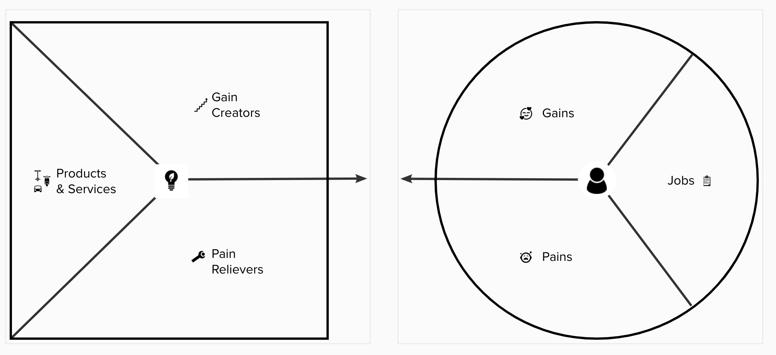
WHAT IS A VALUE PROPOSITION CANVAS

Slide 5
1. Create individual canvases for each of your beneficiary segments. Conduct customer research to gather insights into these segments and their pain points.
BEST PRACTICES - VALUE PROPOSITION CANVAS
Notes:
This fit is generally termed as product market fit
DONT - assume the customer pains and gains

Slide 6
2. Look at the Value Proposition Canvas as two independent sections. Customer profiles and their wants and needs are out of your control, whereas the products and services are in your control to define and manage.
BEST PRACTICES - VALUE PROPOSITION CANVAS
Notes:
This fit is generally termed as product market fit

Slide 7
3. Include emotional and social elements/jobs of the customer profile.
BEST PRACTICES - VALUE PROPOSITION CANVAS
Notes:
This fit is generally termed as product market fit

Slide 8
4. DON’T create a customer profile based on the products on hand.
BEST PRACTICES - VALUE PROPOSITION CANVAS
Notes:
This fit is generally termed as product market fit

Slide 9
5. DON’T make it mandatory to map all pains and gains to your products and services.
BEST PRACTICES - VALUE PROPOSITION CANVAS
Notes:
This fit is generally termed as product market fit

Slide 10
What, if any, seemed challenging or new with the Value Proposition Canvas?
DISCUSS
Notes:
This fit is generally termed as product market fit

Slide 11
Draft your hypotheses

Slide 12
We believe … [ feature and to the user group]
Will result in …[benefit]
We will know we are right when …[outcome]
HOW DO YOU DRAFT A HYPOTHESIS
Notes:
Bakes in the user informed decision making into the hypothesis
Is goal based

Slide 13
Prioritize

Slide 14
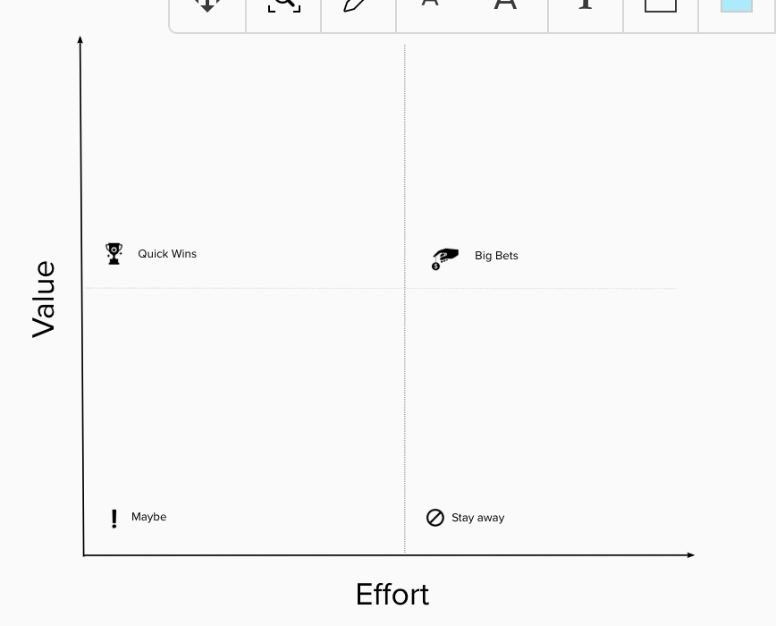
LEAN PRIORITIZATION
Notes:
This fit is generally termed as product market fit

Slide 15
Working iteratively

Slide 16


Nailed it!
Notes:
This one isn’t open source —

Slide 17
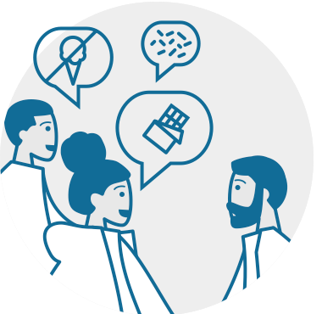
Learn about the problem you’re trying to solve. (don’t worry about the solution yet!)
Humaaans by Pablo Stanley

Slide 18

Try things by making prototypes — then test them and see how it goes.

Slide 19
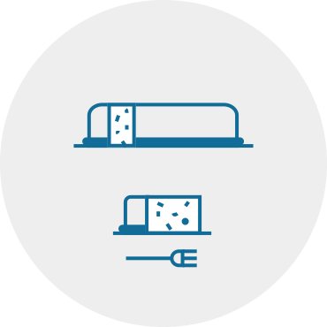
Once you know a little more about what will solve the problem, build part of it in a way you can show to users.

Slide 20

Get feedback from your users!
Avataaars by Pablo Stanley

Slide 21
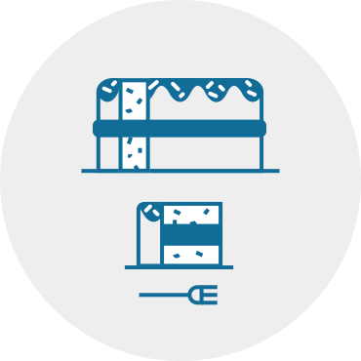
Incorporate your feedback and make an improved version for real people.

Slide 22

Keep going!
Add details piece by piece, getting lots of feedback as you go.

Slide 23
This instead...
Learn about the problem
Make prototypes
Scale up (a little)
Get feedback from your users
Adjust and make a new version
Rinse and repeat!
Humaaans & Avataaars by Pablo Stanley
Notes:
Alternate — 1 slide

Slide 24
Example: FedRAMP dashboard
Notes:
RANDY TO PRESENT -- talk about how it’s still getting new features added
Let’s look at how an Agile 18F project proceeded. It’s a shallow look—just seeing how the home page progresses over time. But it’s a helpful look at things.

Slide 25
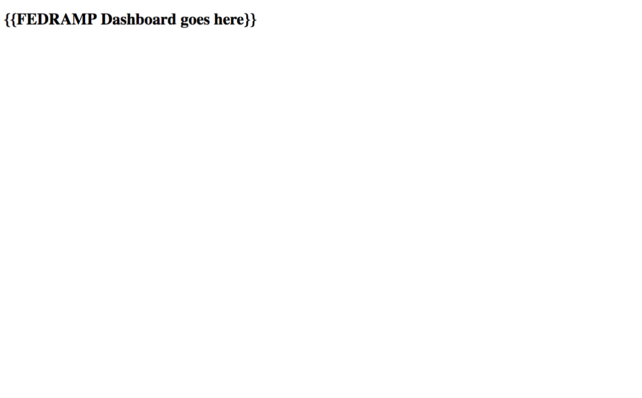

Slide 26

‹#›

Slide 27

‹#›

Slide 28
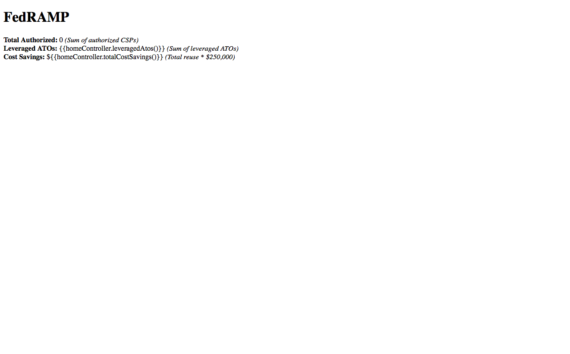
‹#›

Slide 29
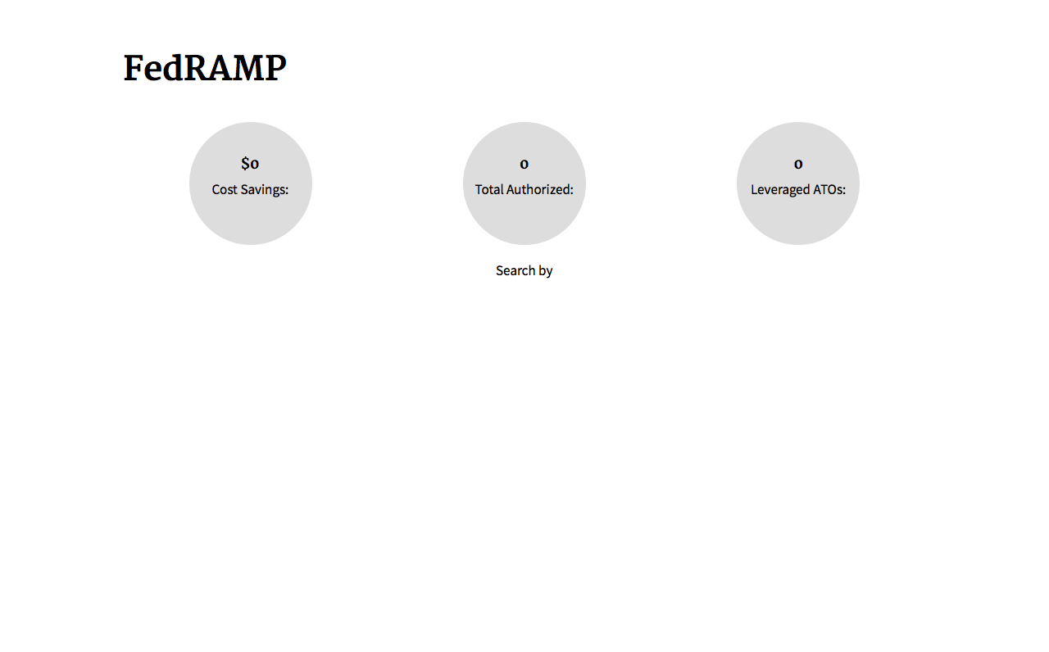
‹#›

Slide 30
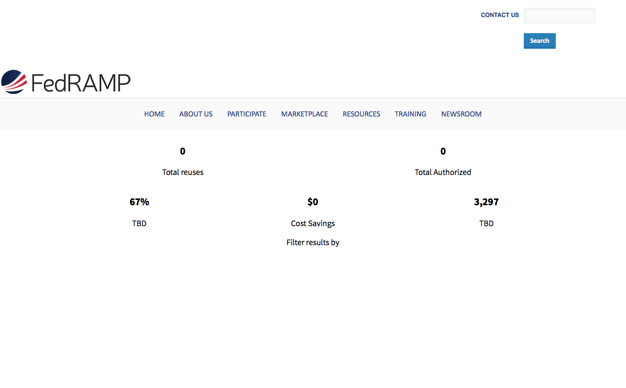
‹#›

Slide 31
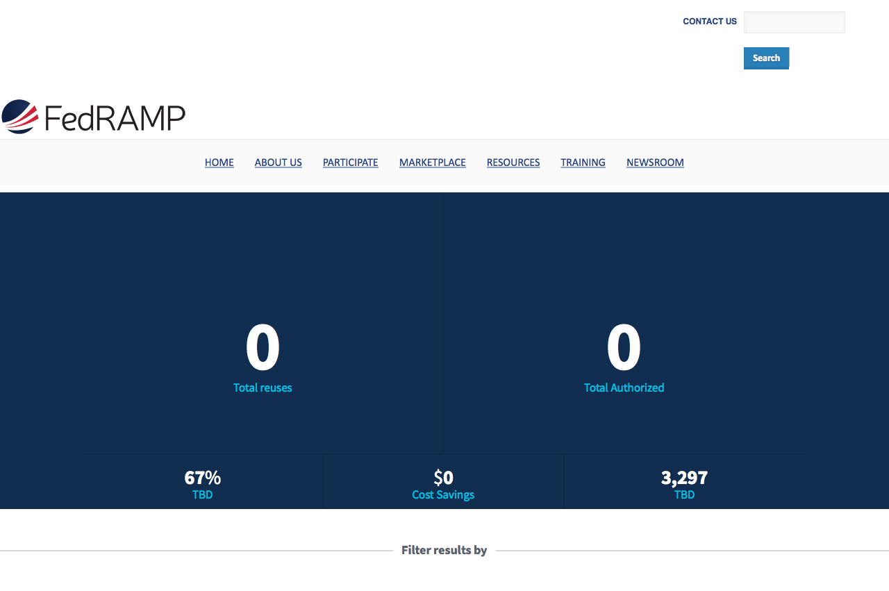
‹#›

Slide 32
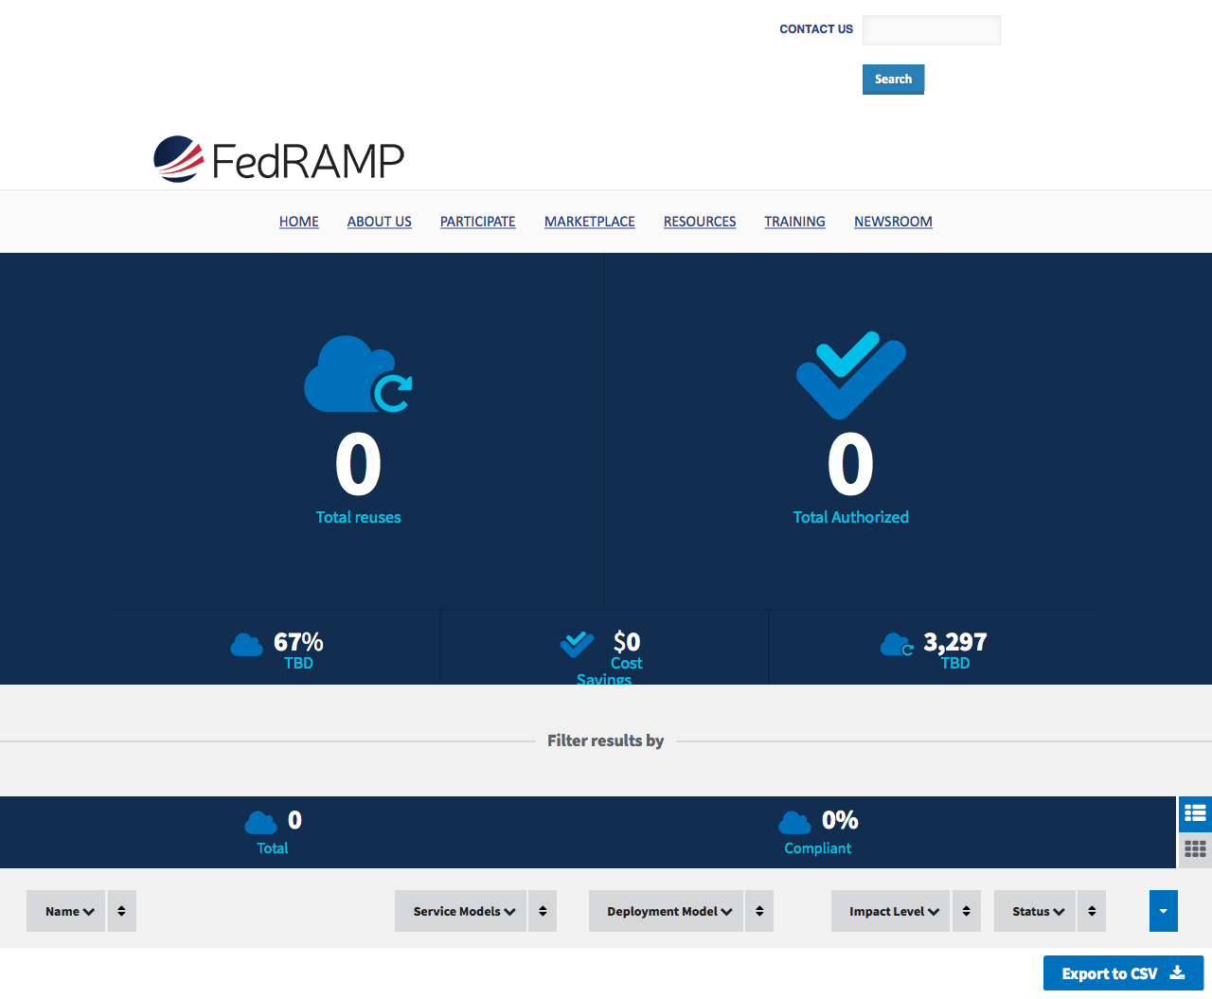
‹#›

Slide 33
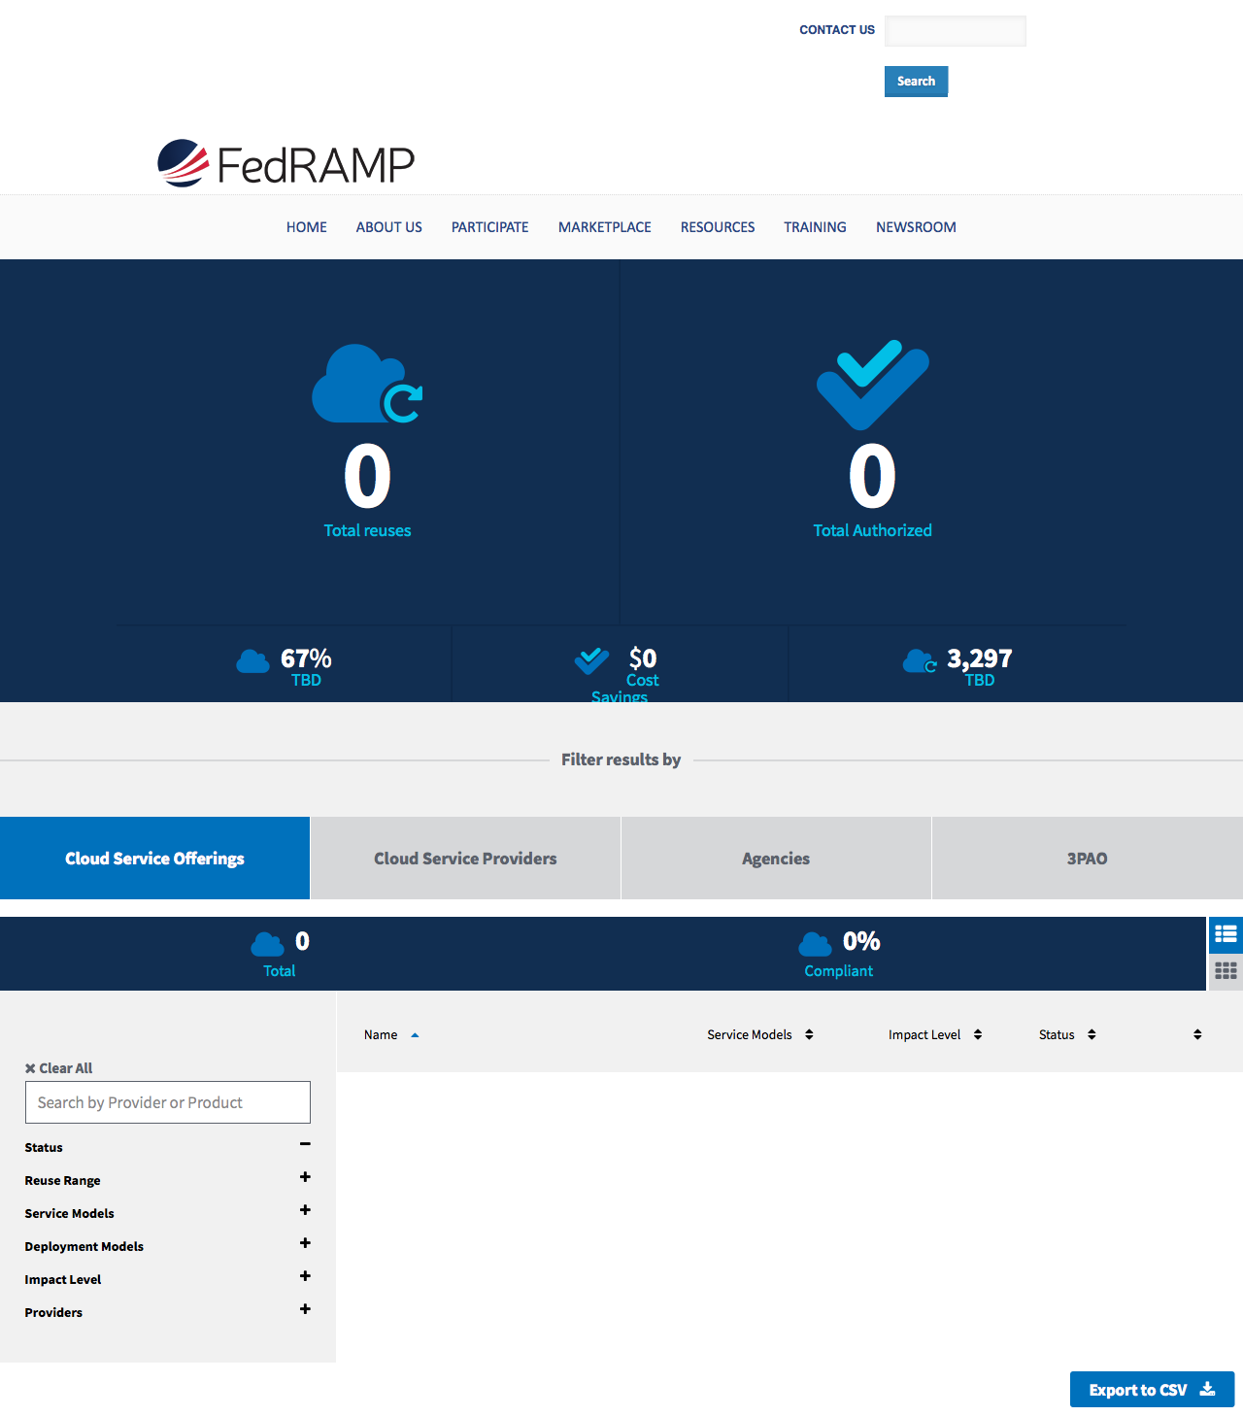
‹#›

Slide 34
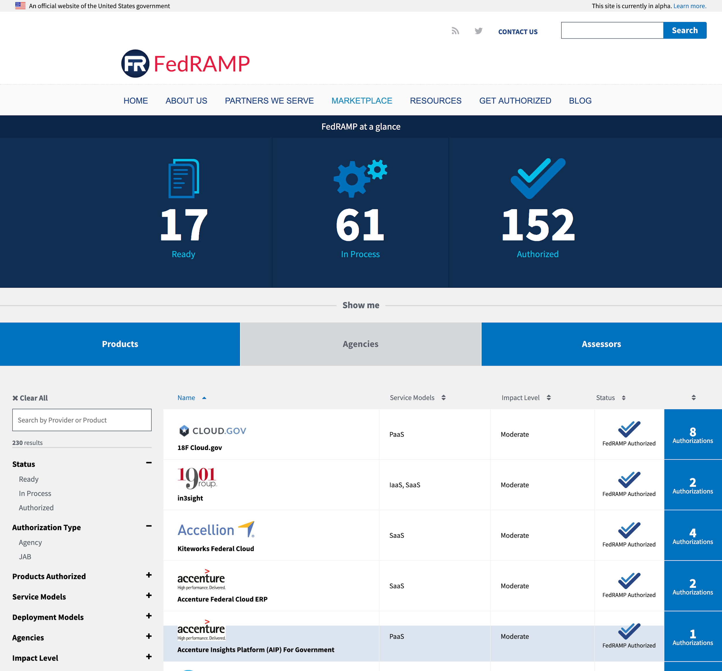
‹#›
Notes:
https://marketplace.fedramp.gov/#/products?sort=productName

Slide 35
Project RevAMPD

Slide 36
Next up on RevAMPD
Develop goals and measures of success for RevAMPD
Draft your hypotheses from the value proposition canvases
Prioritize your hypotheses to identify areas you want to experiment

Slide 37
Suggested reading/viewing
Lean, Agile and Product thinking
18F Product Guide

Slide 38
Thank you!

